Slide 1

WEB DASHBOARDS
Session I

Slide 2
1. Introduction to Dashboards 2. Dashboard Viewer capabilities 3. Dashboard Designer 4. Create new Dashboard layout 5. Bind to Data
TABLE OF CONTENTS

Slide 3

Dashboard
Dashboard Layouts It allows users to create dashboard layouts in a Uppwise application and provides an intuitive UI that facilitates data binding, shaping, layout design, etc. Many of these normally complex tasks can be accomplished with a simple drag-and-drop operation, allowing you to start creating dashboards immediately.
Dashboard Layout Viewer enables user to display dashboards in application.
Dashboard Layout Designer provides a comprehensive UI for designing dashboards from scratch which can be binded easily with the real time application data using available data sources.
Here, Available data source is SQL tables & JSON which contains set of APIs that can be binded to the Items of your dashboard layouts.

Slide 4
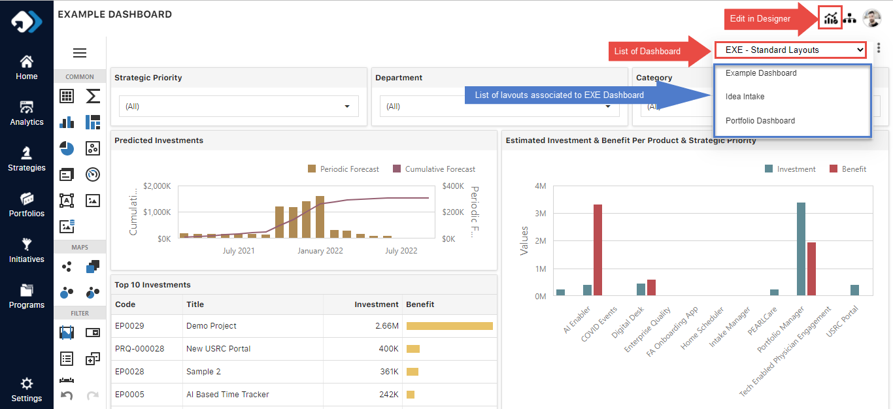
Dashboard Viewer
The viewer Surface allows user to filter & export the individual items as well as the entire dashboard layout.
It shows List of Dashboard available for User
The list of layouts accessible to user in the current dashboard.
Dashboard layout Export is available in Excel & PDF
Permitted users can modify or create new using Edit in Designer. For other users, this button will be hidden.
Viewer has the accessibility to use Items in dashboard they can extract required information.

Slide 5
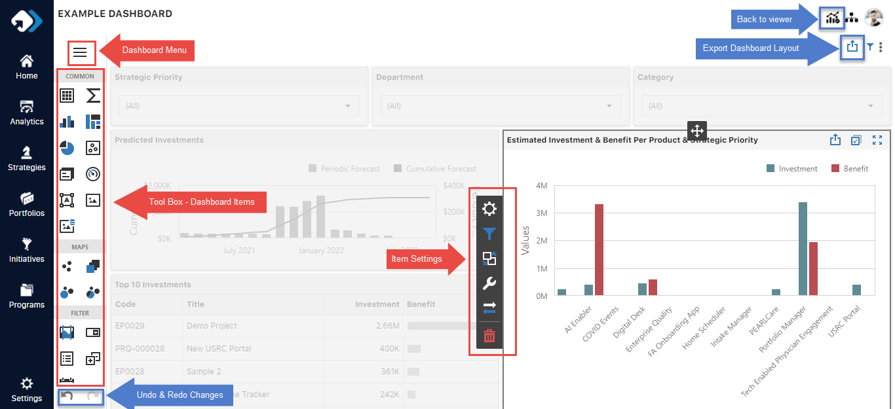
Dashboard Designer

Slide 6
Dashboard Designer
The Design Surface displays a dashboard layout structure and contents. You can use the tools on the Designer panel to design the layout with a simple drag-and-drop operation.
Dashboard Menu – To Manage the layout.
Toolbox - To design the layout.
Undo – To reverse the last changes done in layout.
Redo – To restore any actions that were previously undone using an undo.
Viewer – To return to viewing mode from designer.
Dashboard Item Settings – To configure Item setup.

Slide 7
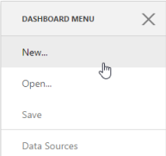
Create New Dashboard Layout
You can create a new dashboard in two ways :
You can open the dashboard menu and click the New button... as shown in image.

Slide 8
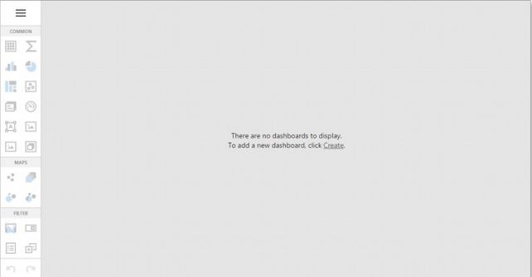
Create New Dashboard Layout
or click Create in the following message if your application does not have any dashboards. as shown in image.

Slide 9
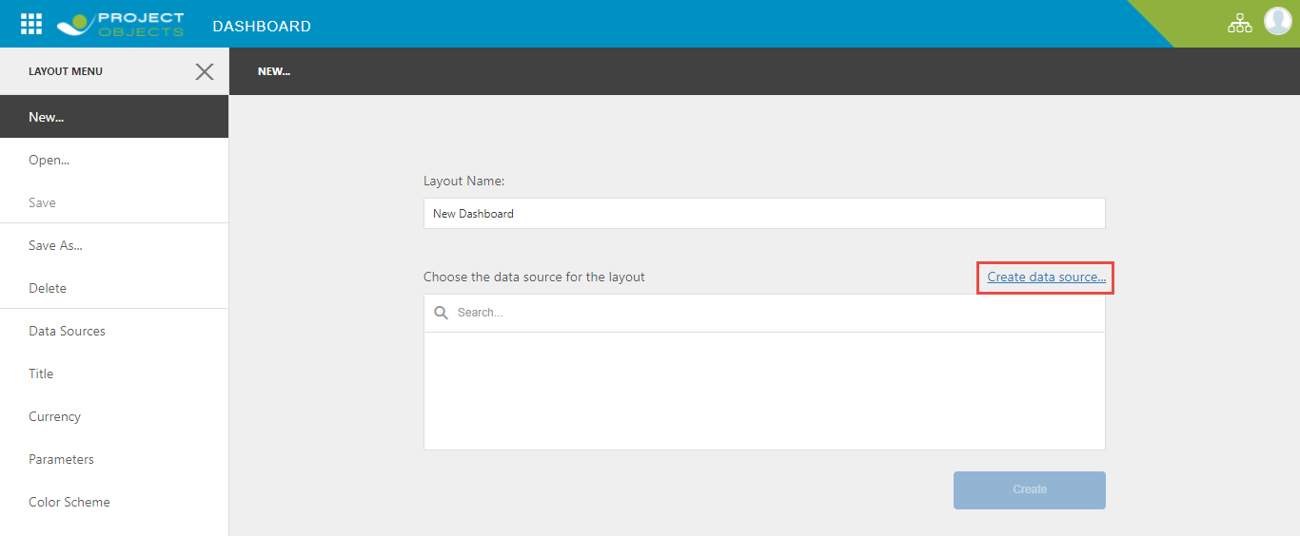
After that, the New... Page is invoked. Here you can set a layout name, create data source & connect to an existing JSON data source.

Slide 10
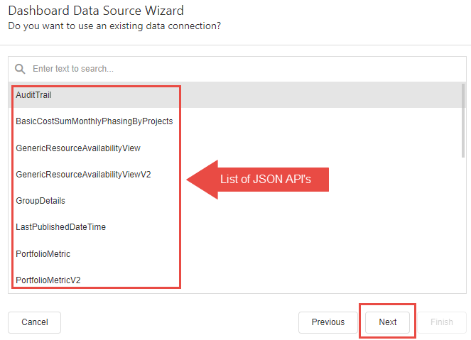
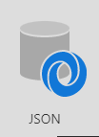
Provide Data to New Layout
There are two types of data sources available for End user Analytics & JSON. User can select any from Dashboard DS wizard.
Analytics is a collection of SQL Tables exposed in query builder.
JSON is a collection of APIs exposed for end user.

Slide 11
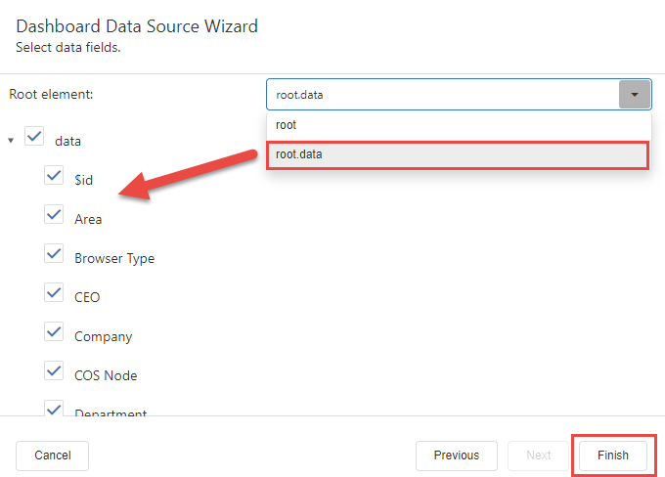

Provide data to new Dashboard Layout
Select the root. Data option from drop down list.
Click on Finish to add the selected fields
Then on Create button to add the specific API to new layout.
Now these selected fields will be available in Dashboard layout Items.

Slide 12
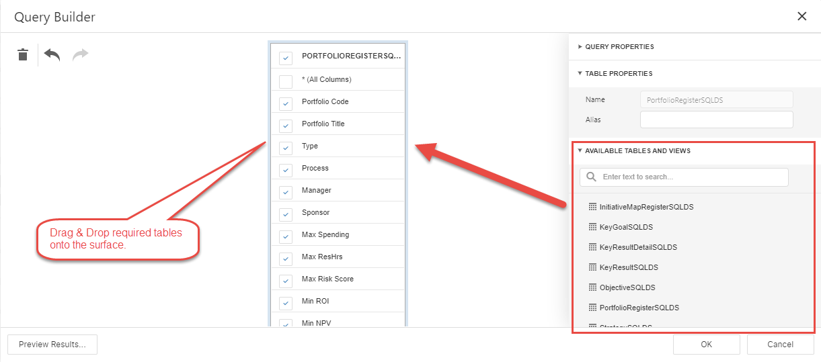
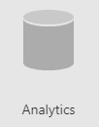
Provide Data to New Layout
There are two types of data sources available for End user Analytics & JSON. User can select any from Dashboard DS wizard.
Analytics is a collection of SQL Tables exposed in query builder.
JSON is a collection of APIs exposed for end user.

Slide 13
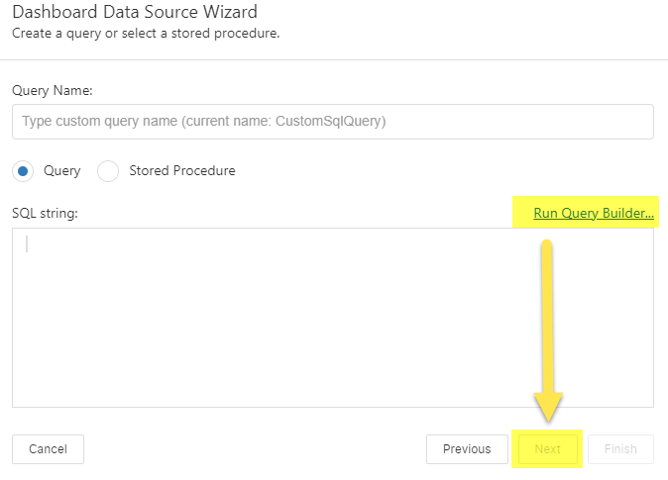

Provide data to new Dashboard Layout
Select the Analytics Data Source type.
Click on Next then select SQL Data source
Again, Click on Next then then click on Run Query Builder.
Now the Query builder will invoke. Here you can select required tables as Ds for your layout.

Slide 14
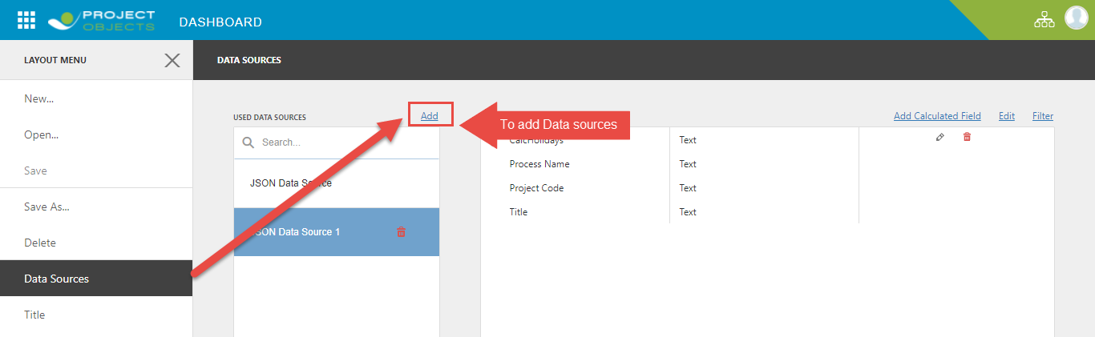
Provide Data to Existing Layout
To invoke this wizard, go to the Data Sources page of the dashboard menu and click on Add button.
In the invoked window click on Create data source.... & the rest of the process is same.

Slide 15
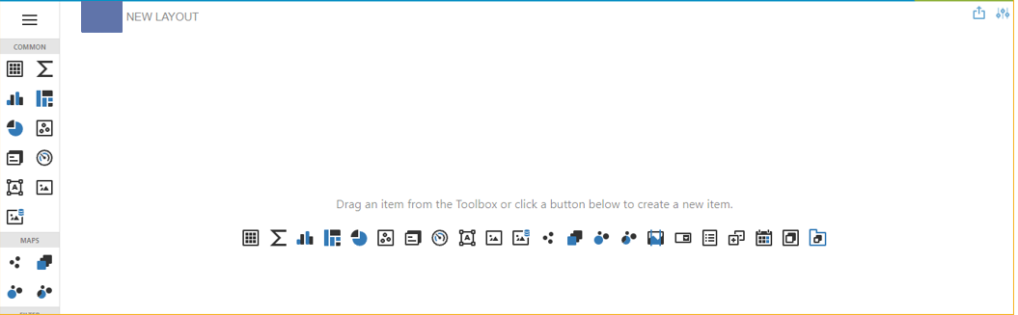
New Dashboard Layout
After creating a dashboard and provide data to it, add dashboard items to display visual or textual information in a dashboard.

Slide 16
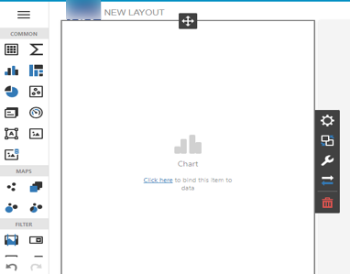
New Dashboard Layout
To create a layout item, drag an item from the Toolbox into the dashboard surface.
This creates an empty dashboard item, which you can now configure.
To completely design a layout item, perform the following steps.
Bind the item to data.
Set specific item settings based on its type.
Perform the required data shaping operations (such as grouping, sorting, filtering, etc.).
Use the interactivity features to enable interaction between various items.
Adjust the item's position and size and specify the dashboard item caption settings.
To remove the item from the dashboard surface, use the Delete button in the item menu.

Slide 17
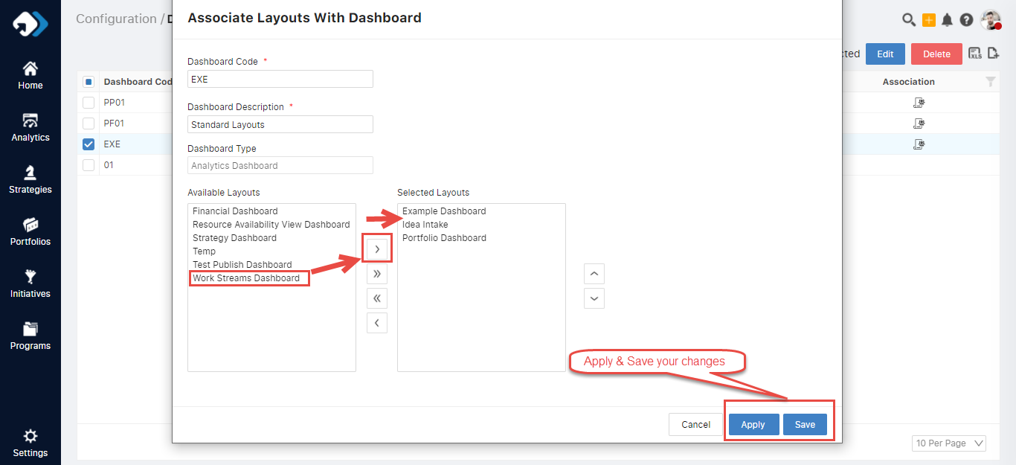
Dashboard Layout Visibility Configurations
To Enable/Disable the layout’s visibility user is required to follow the below Steps:
Login – Into the application
Go to Main Menu.
Go to company Settings menu.
Go to Dashboards setting.
Edit your Dashboard.
Move your layout from list of Available Layouts to Selected Layouts lane using arrow buttons.
Save the changes.

Slide 18
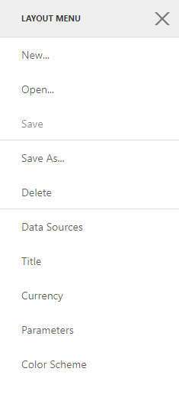
Dashboard Layout Menu
The Design Surface contains layout Menu setup to manage below mentioned basic operations :
New – To create new layout.
Open - To open any existing layout.
Save – To save the changes done in layout.
Save As – To create a copy of current layout.
Delete – To remove the current layout.
Data Source – To provide the data to layout.
Title – To set the Header title & Logo image in layout.

Slide 19
Thank You.

